Slide 1

City of Mainz - Becoming a Digital Parking Operator
Nils Teske, Uwe Brück, Kim Schreiber
PMG Parken in Mainz GmbH
Presented by Christian Grzona (evopark GmbH)

Slide 2
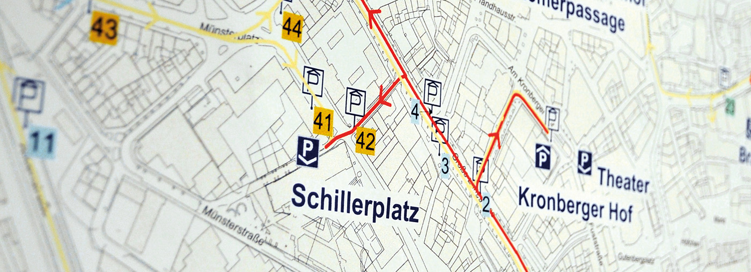
Platz für alle. / Space for everyone.
Established 1983
Owners: MAG / City of Mainz
10,000+ Parking Spaces
25 Car Parks
Copyright: PMG Parken in Mainz GmbH
Key Facts - PMG Parken in Mainz GmbH
© PMG · Parken in Mainz GmbH
02/2022

Slide 3
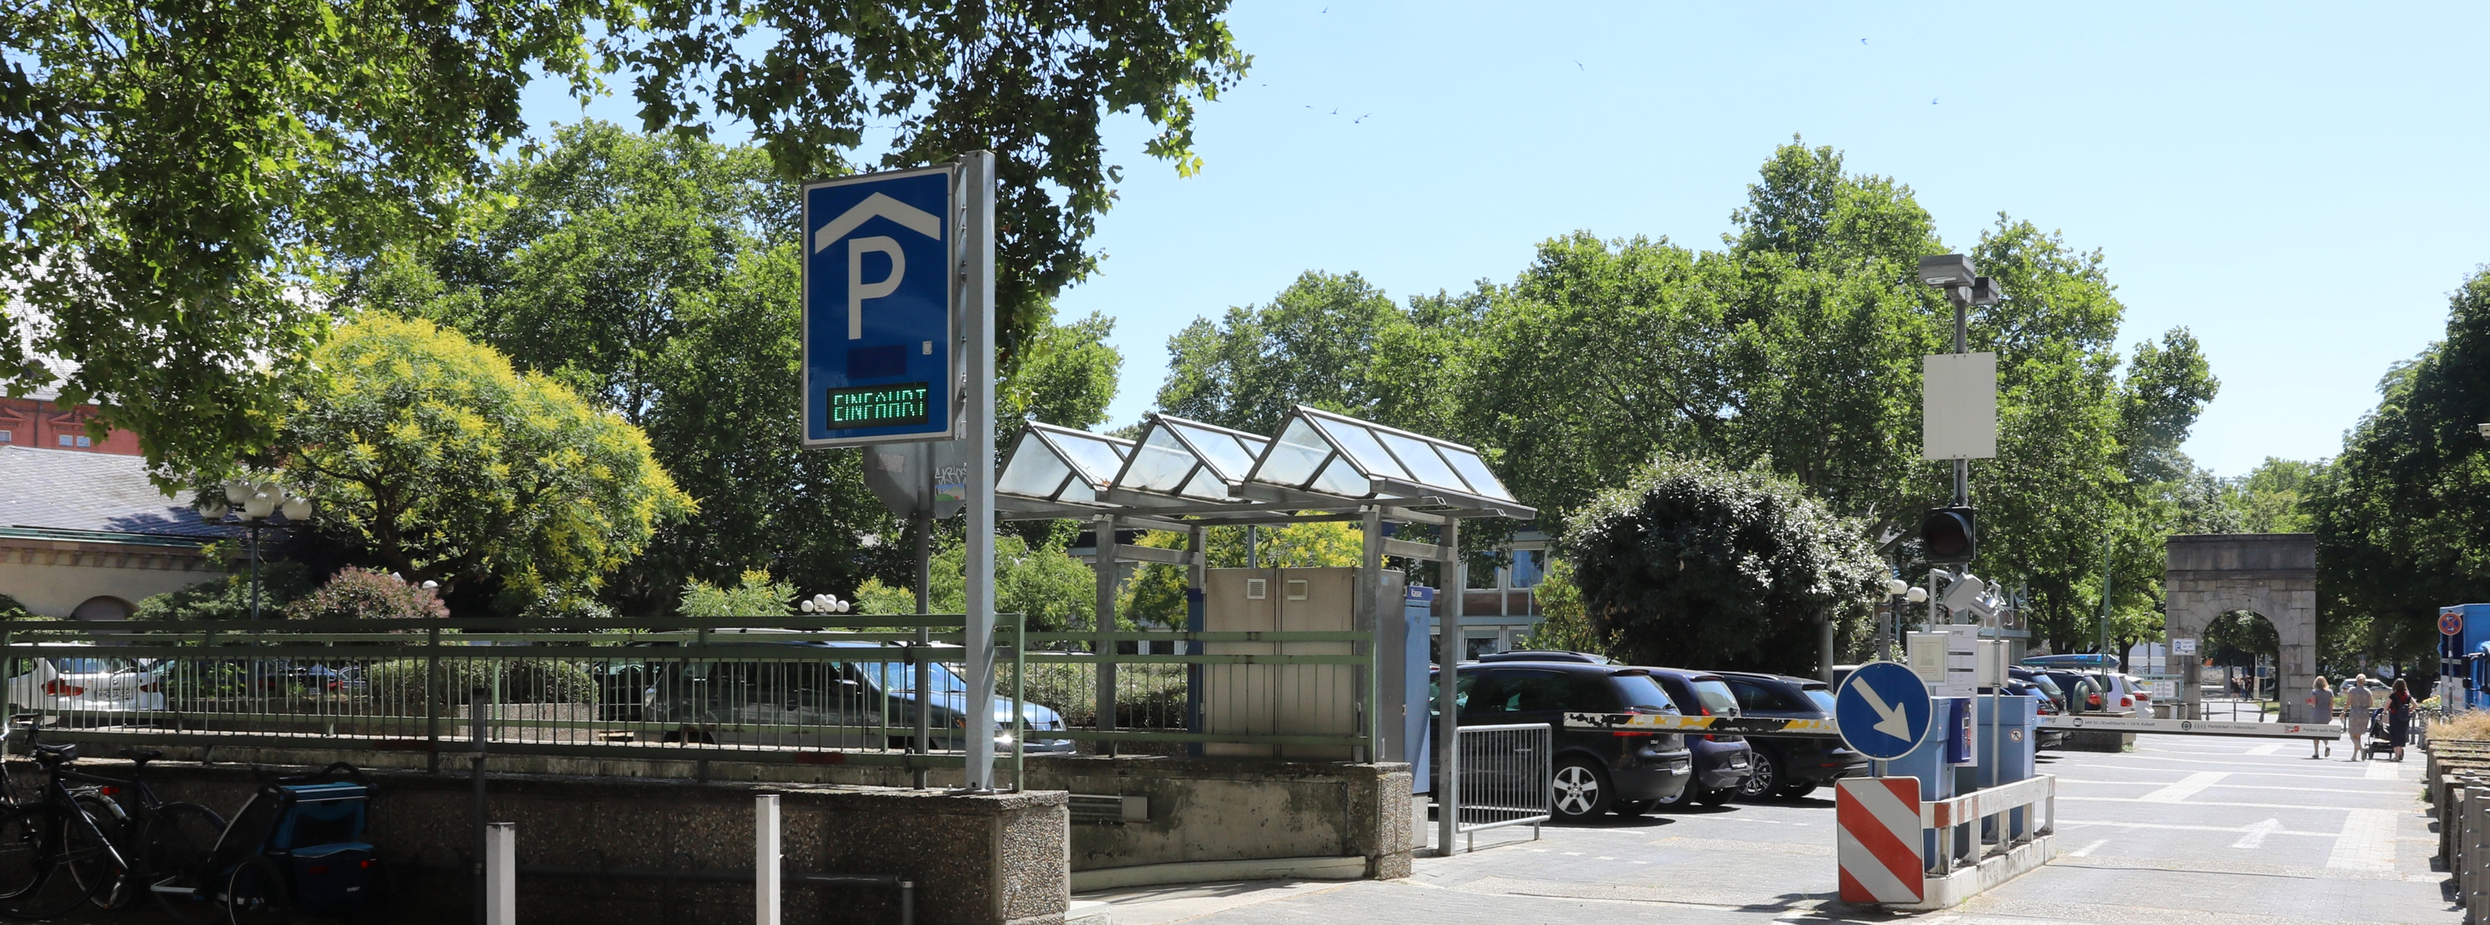
Platz für alle. / Space for everyone.
Planning
Implementation
Operation
Copyright: PMG Parken in Mainz GmbH
40 Years of Experience / Holistic Approach
© PMG · Parken in Mainz GmbH
02/2022

Slide 4
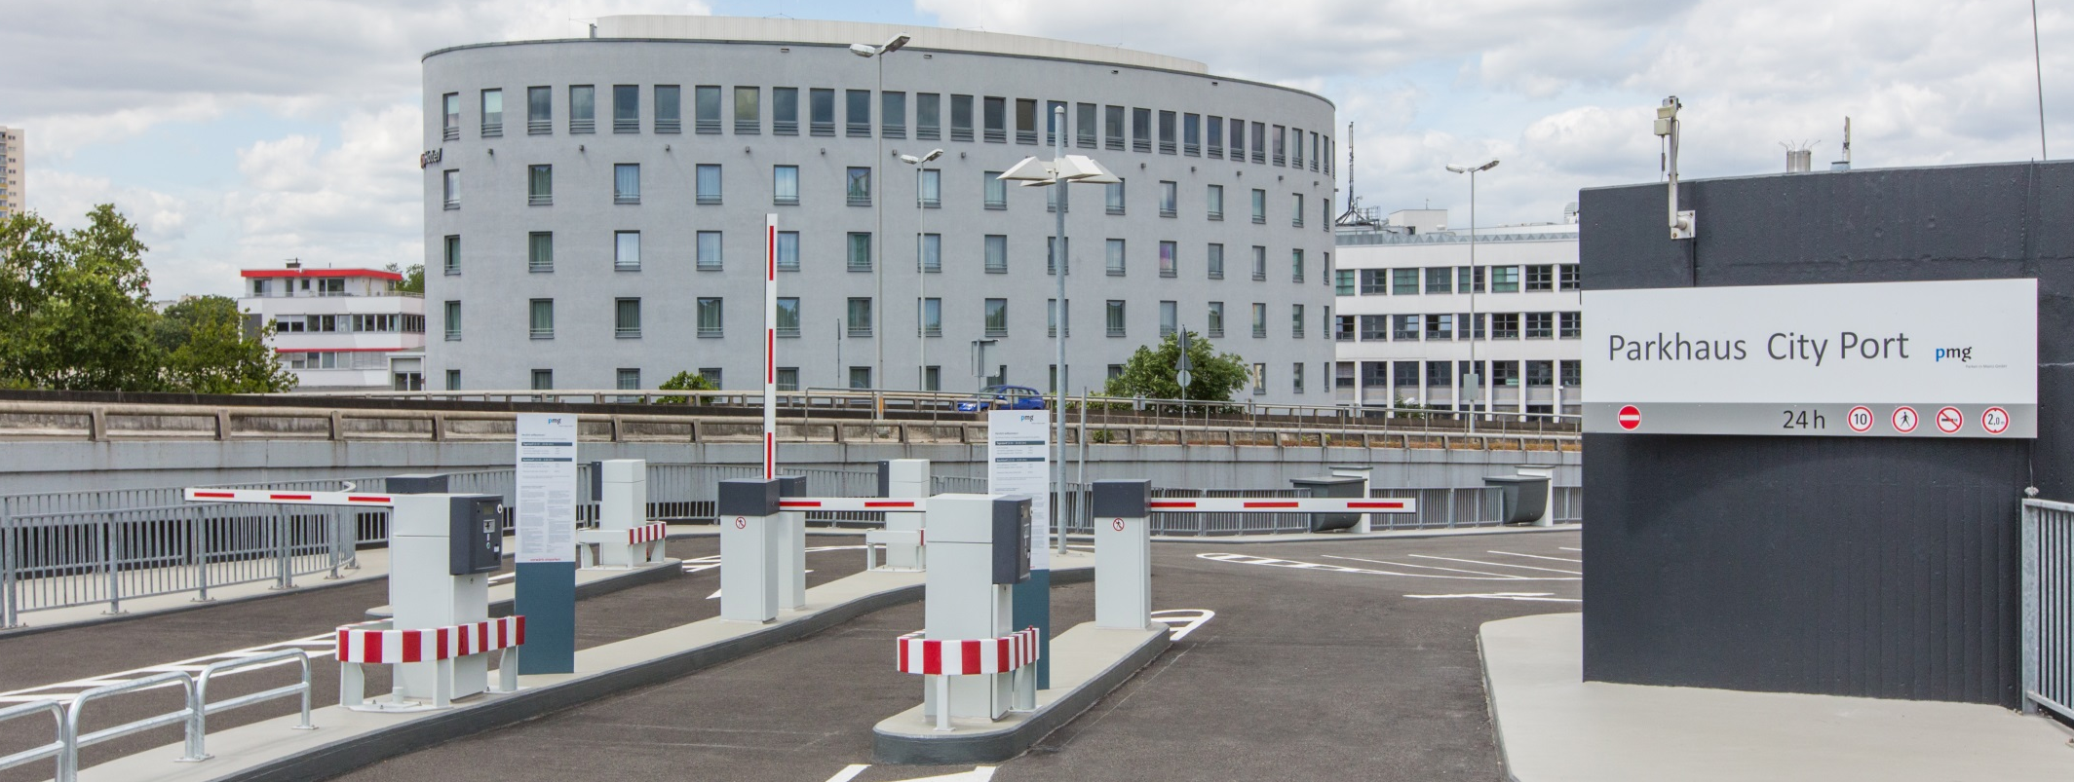
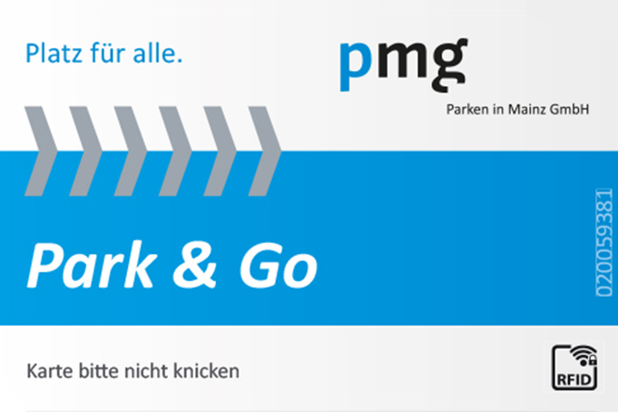
Platz für alle. / Space for everyone.
“Customized Standard” (Hardware + Software)
Seamless Solution for
Perm Parkers + Frequent Parker Program (Park&Go)
Centralized Virtual Management System
Copyright: PMG Parken in Mainz GmbH
Technology Pillars
© PMG · Parken in Mainz GmbH
02/2022

Slide 5
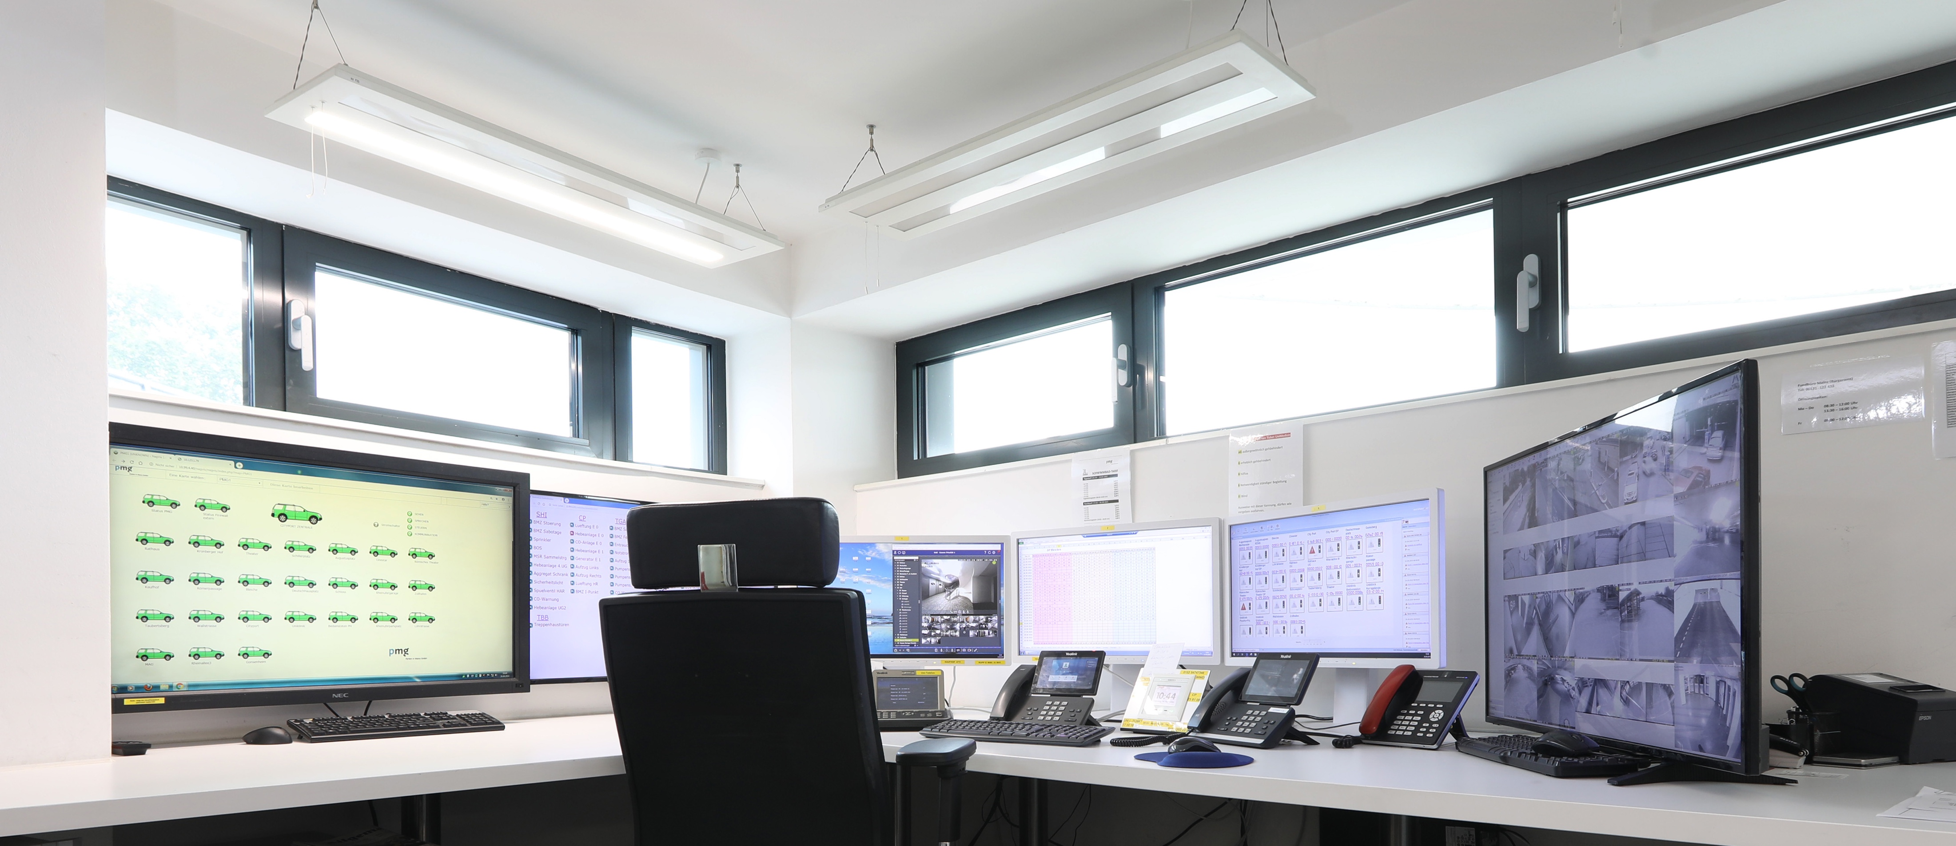
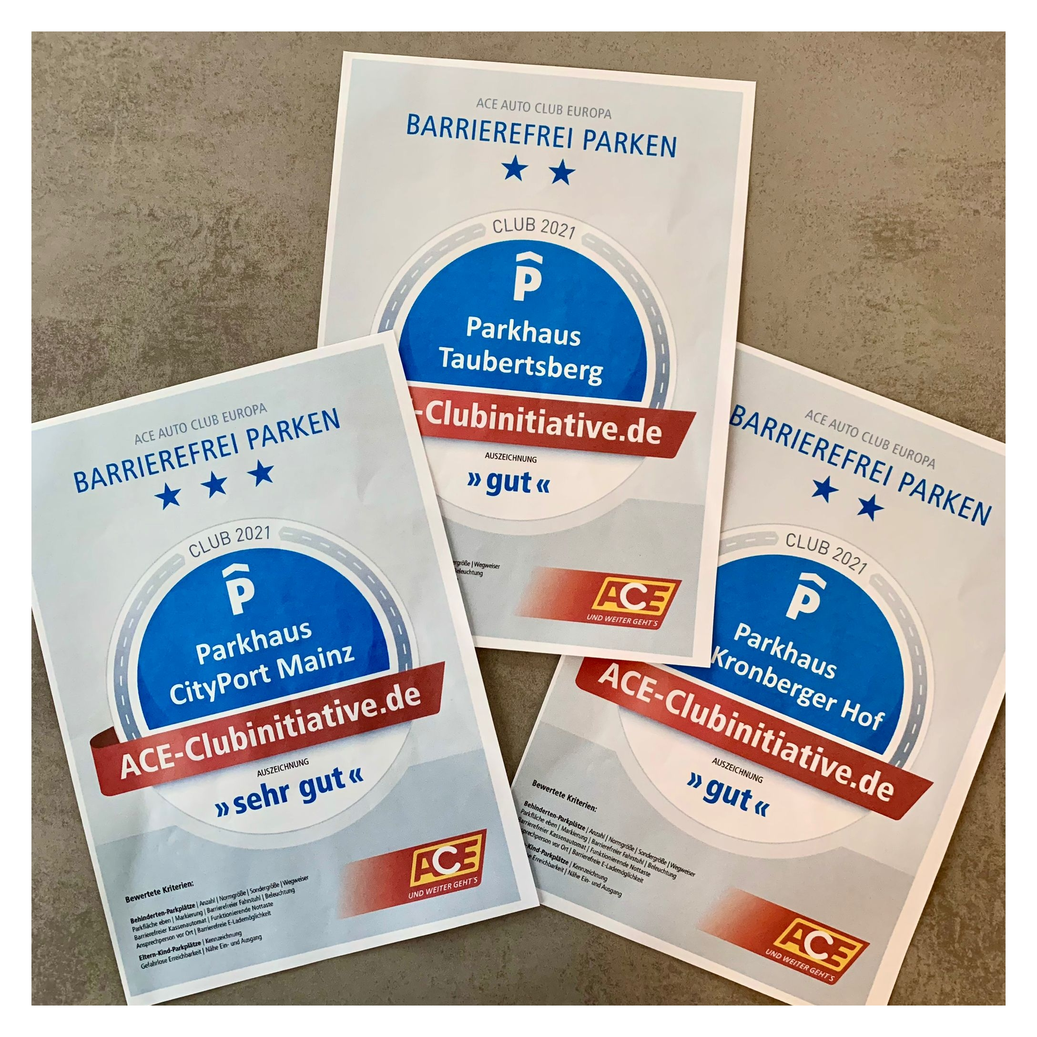
Platz für alle. / Space for everyone.
24/7 Operation
Central Control Room
High Safety and Usability Standards
“Human Centric Approach”
Skilled Staff (through Continuous Training)
Copyright: PMG Parken in Mainz GmbH
Coping with Ever-changing Requirements
© PMG · Parken in Mainz GmbH
02/2022

Slide 6
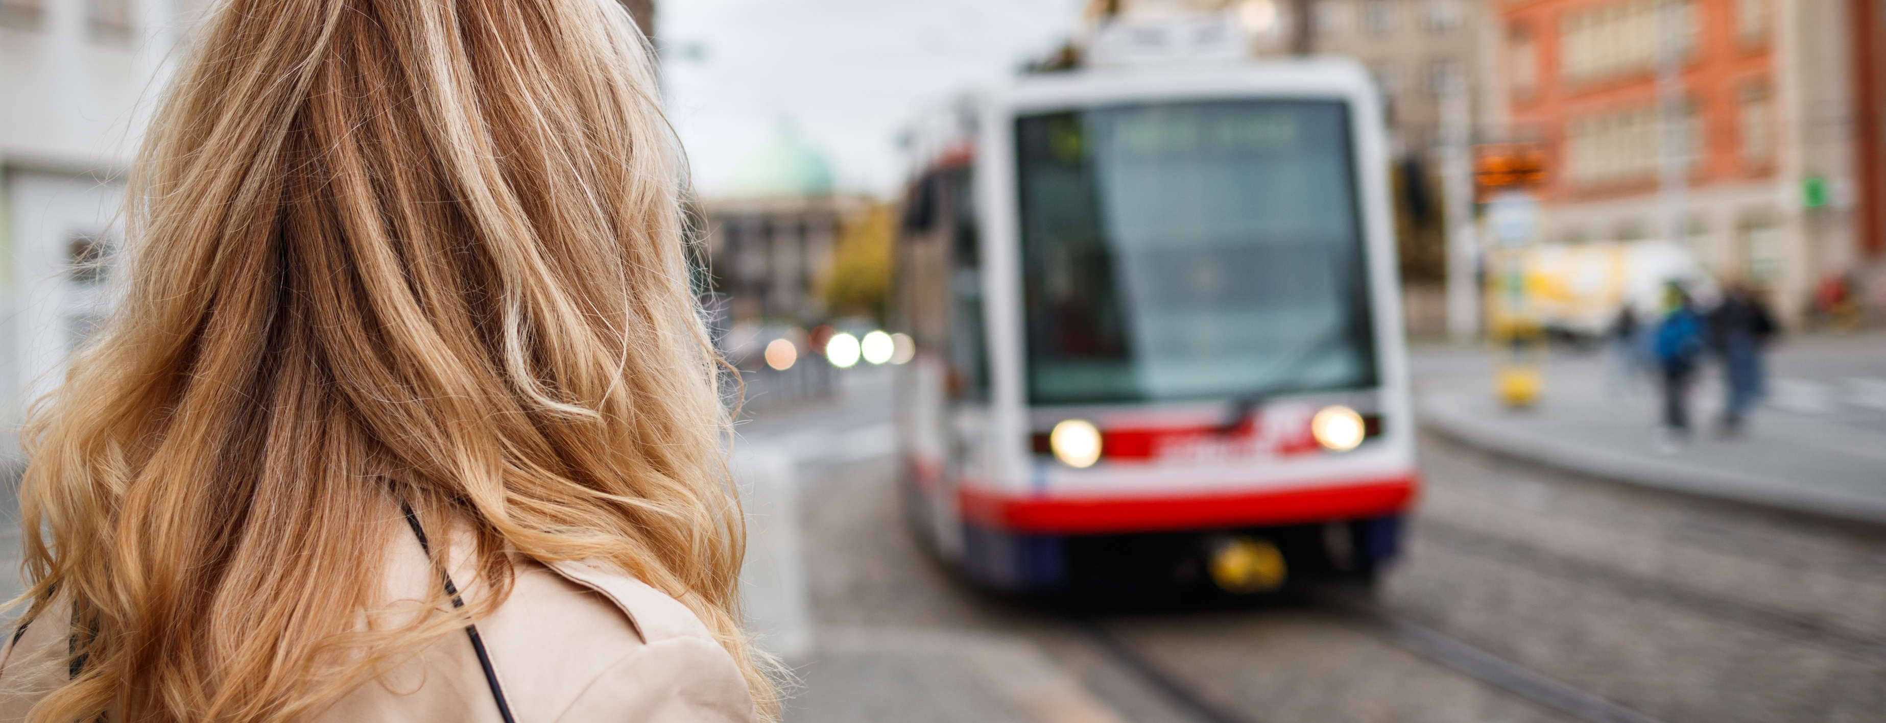

Platz für alle. / Space for everyone.
Park & Ride Solution
(Free Public Transport for PMG Parkers)
Integrated Retailer Concept
“Parken auf’s Haus”
(50% Discount)
Theatre, Cinema and Event Tariffs
Copyright: Adobe Stock
Parking as Part of the Urban Landscape
© PMG · Parken in Mainz GmbH
02/2022

Slide 7
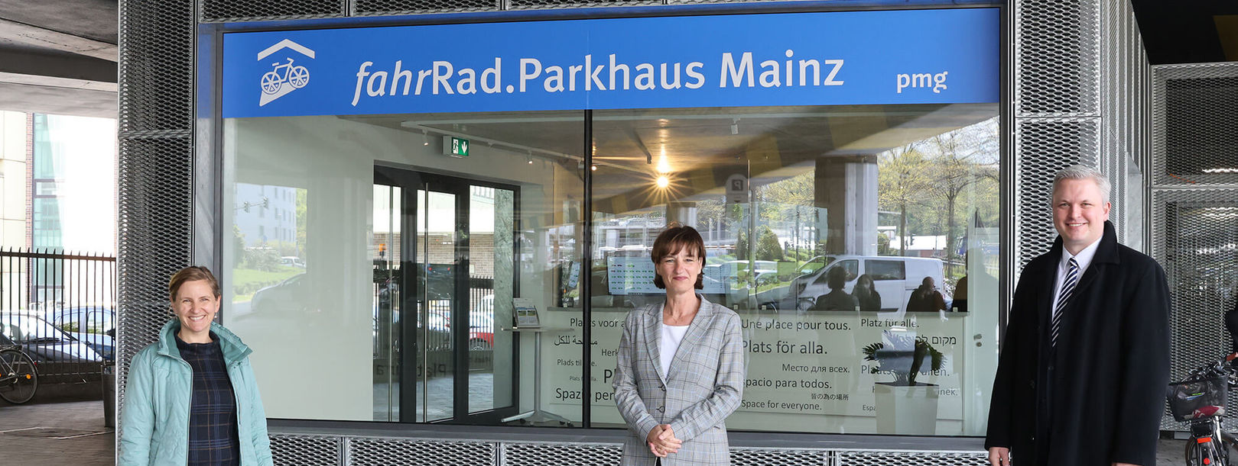
Platz für alle. / Space for everyone.
Technology First Mover / Trendsetter
Beyond Cars Approach
Bicycle Parking
Digital + Cashless Access
Copyright: PMG Parken in Mainz GmbH
Parking Operation – Adapted to New Modal Split
© PMG · Parken in Mainz GmbH
02/2022

Slide 8
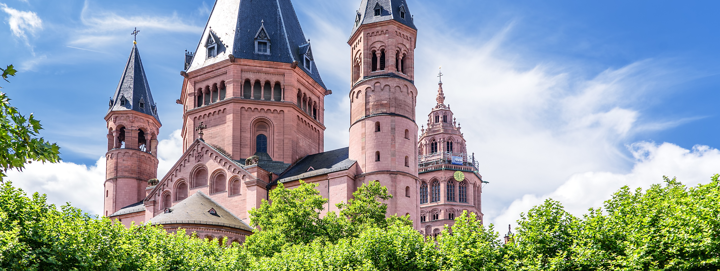
Platz für alle. / Space for everyone.
Copyright: Adobe Stock
City Regulation since 2015: On-Street Max = 1h
On-Street + Off-Street Parking Apps integrated
(e.g. EasyPark)
Common Data Lake
Cooperation with Municipality / Public Services
© PMG · Parken in Mainz GmbH
02/2022

Slide 9
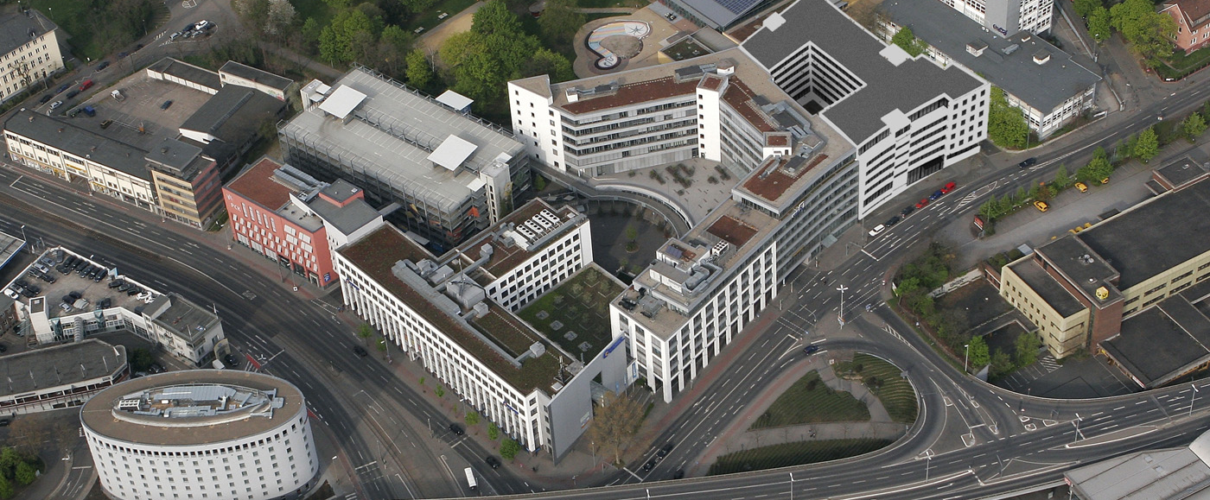
Platz für alle. / Space for everyone.
Data Driven Decision Making
(Pricing Models etc.)
Conversion to License Plate based parking (“Ticketless”)
Develop Effective Measures for Reduction of Park Search Traffic
Copyright: PMG Parken in Mainz GmbH
Future Milestones + Outlook
© PMG · Parken in Mainz GmbH
02/2022

Slide 10


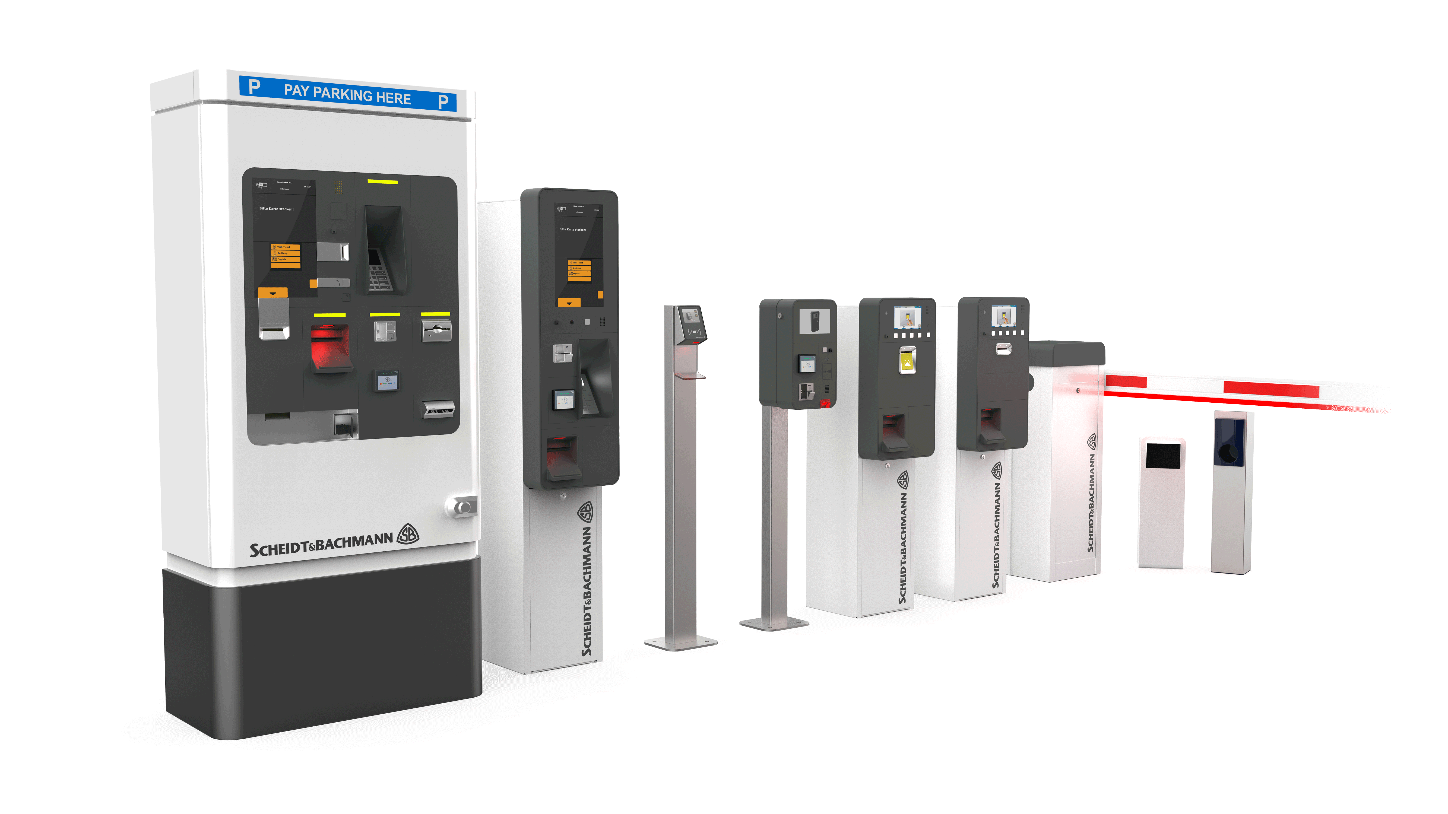
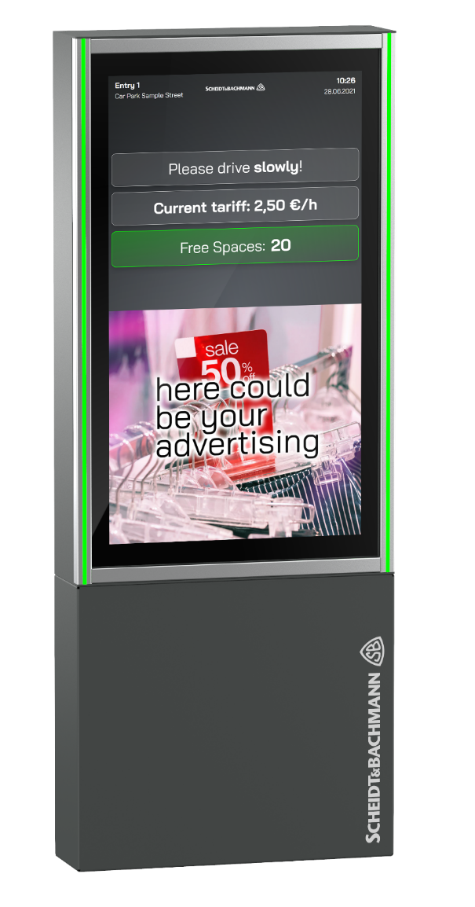
Platz für alle. / Space for everyone.
€
Application Layer
>>
>>
Cloud-based Middleware
Business Logic Parking
Conventional Parking System
>>
>>
Hardware Layer
© PMG · Parken in Mainz GmbH
Copyright: S&B
02/2022

Slide 11


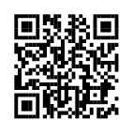
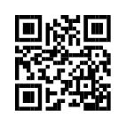
Platz für alle. / Space for everyone.
https://scheidt-bachmann.com
https://evopark.com
Technology Partners
© PMG · Parken in Mainz GmbH
02/2022

Slide 12
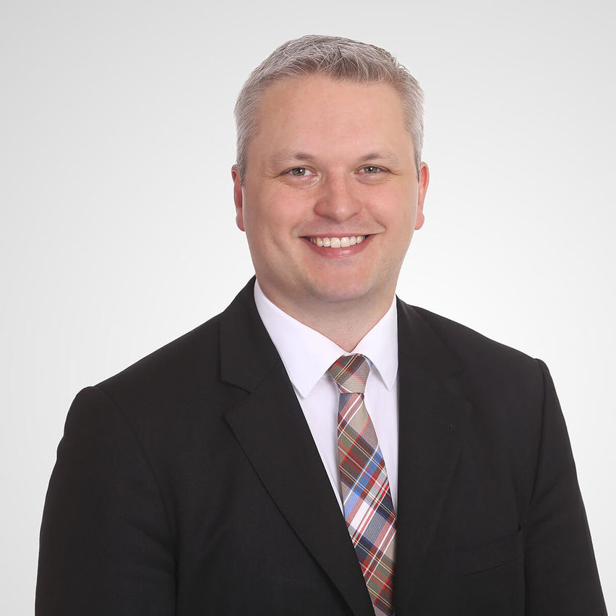
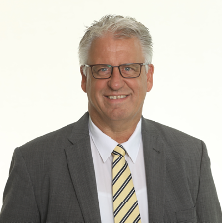
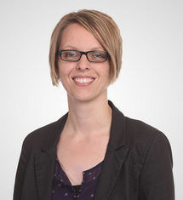



Platz für alle. / Space for everyone.
Nils Teske
Managing Director
teske@parken-in-mainz.de
Uwe Brück
Division Manager Technology
brueck@parken-in-mainz.de
Kim Schreiber
Team Leader PMG Administration
schreiber@parken-in-mainz.de
© PMG · Parken in Mainz GmbH
02/2022

Slide 13
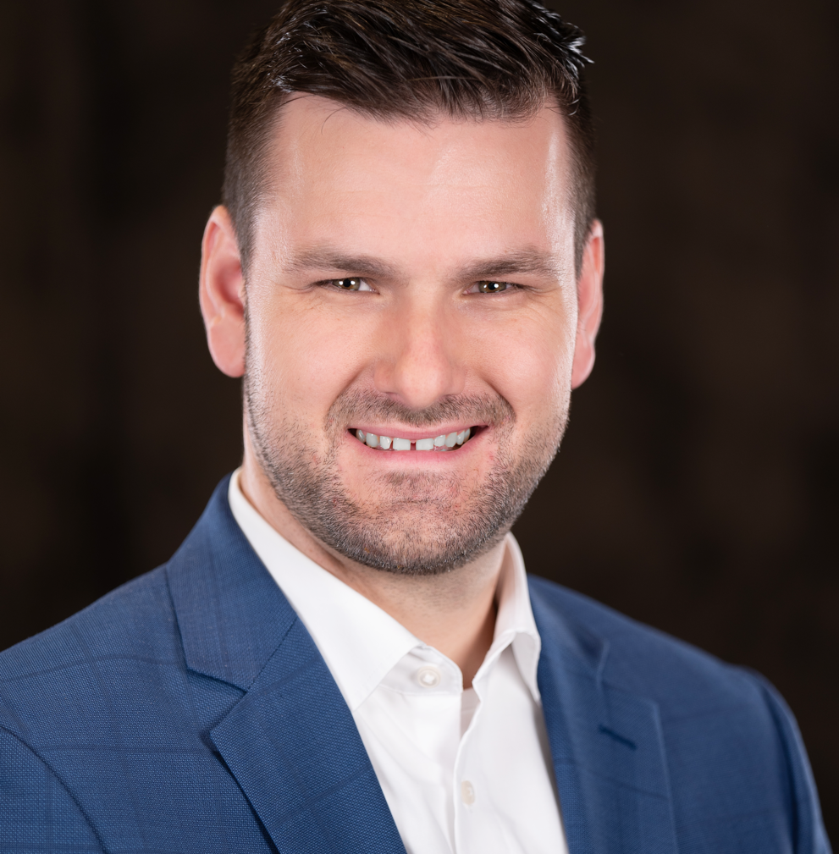
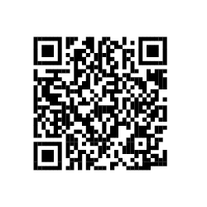
Platz für alle. / Space for everyone.
Christian Grzona
Director Sales & Marketing, evopark GmbH
christian.grzona@evopark.de
Speaker Profile
© PMG · Parken in Mainz GmbH
02/2022

