Slide 1
Tools for a better Parking Management
Stefan Van den Branden
Sint-Niklaas

Slide 2
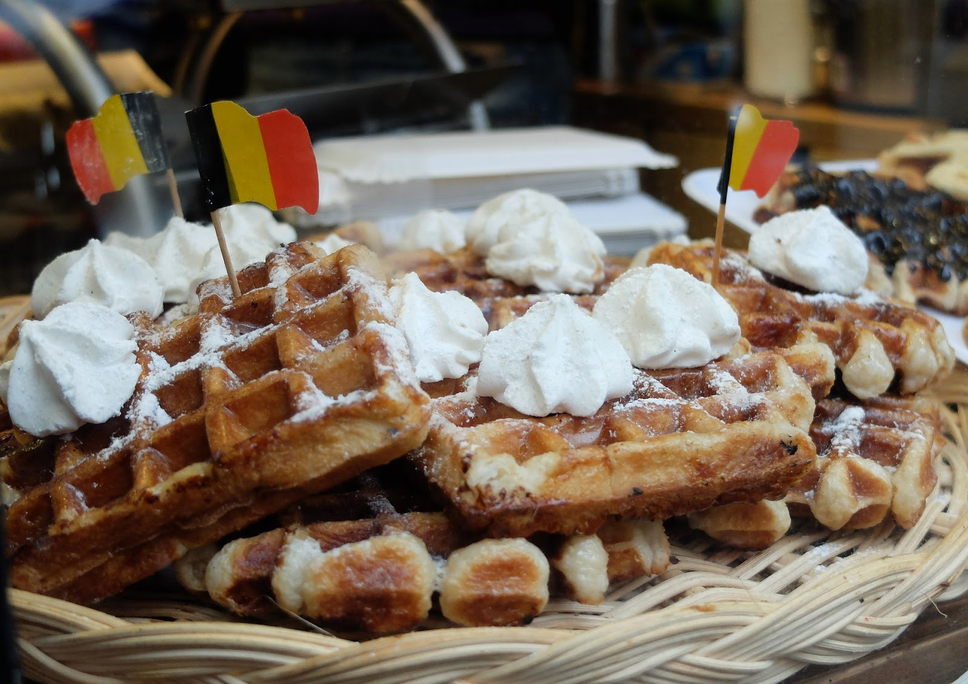
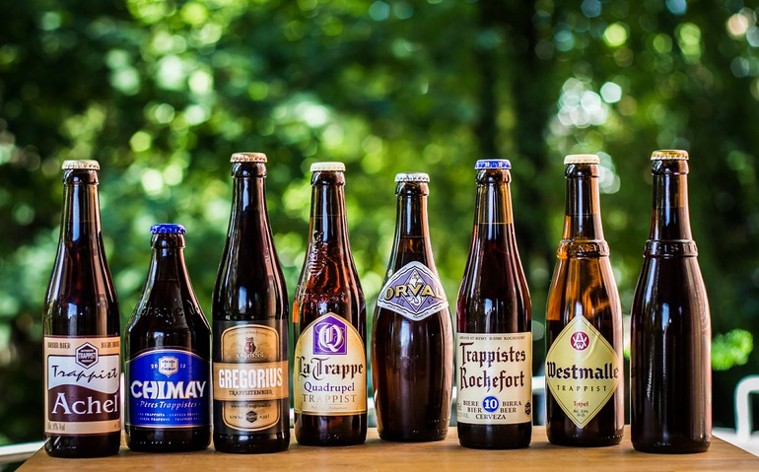

Slide 3
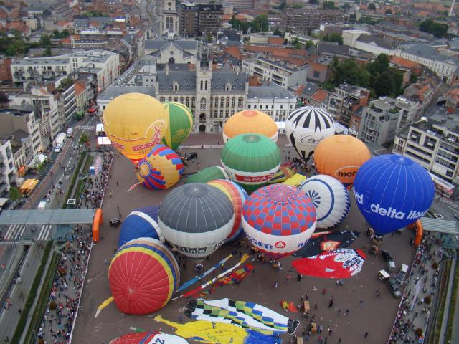
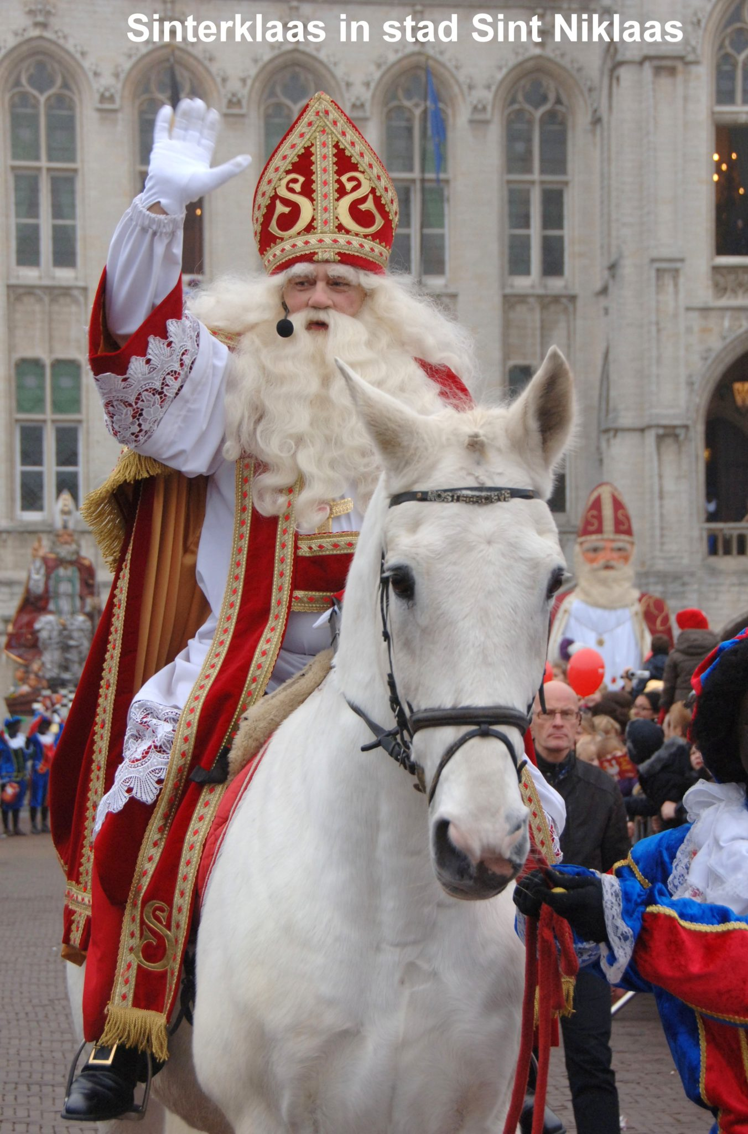
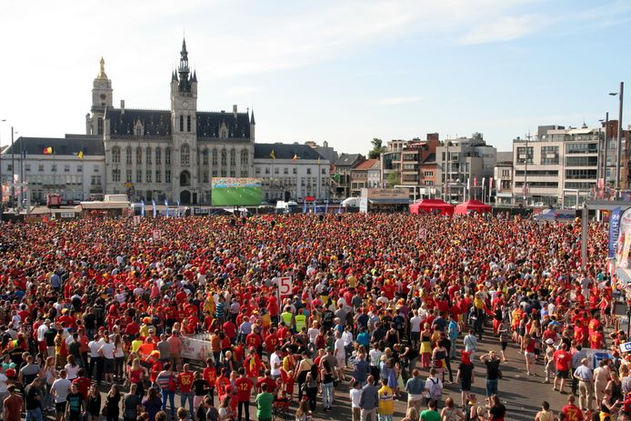

Slide 4
Parking capacity 2022
39.000 population (city centre)
Capacity public parking 11.380
on-street 10.324
Betalende zone 1.402
Pleinen 1.071
Blauwe zone 2.603
Niet gereguleerde zone 5.248
off-street 1.056
P Stationsstraat 196
P Grote markt 360
P Station 500
Capacity private parking 21.926
Eengezinswoningen 5.130 (3.318 won)
Meersgezinswoningen 3.343 (524 app)
Garageboxen 3.848
Private parkings 9.605
On-street licence centre 5.859
1st 5.396
2nd 463

Slide 5
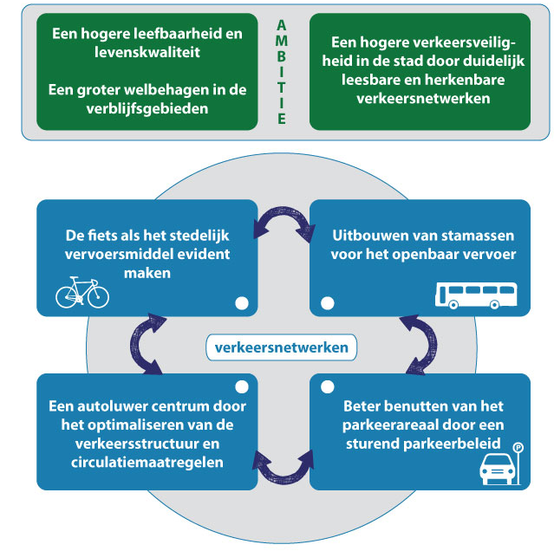
SUMP – targets
To optimize the parking space by using a guiding parking policy

Slide 6
What we actually want…
To use the available parking space more efficient by…
Guiding the right car to the right place

Slide 7
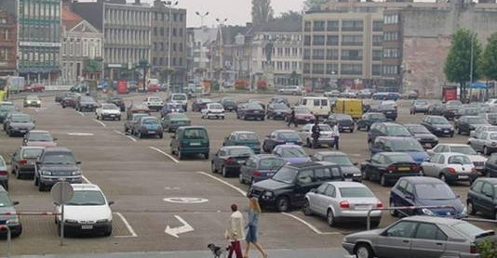

Slide 8
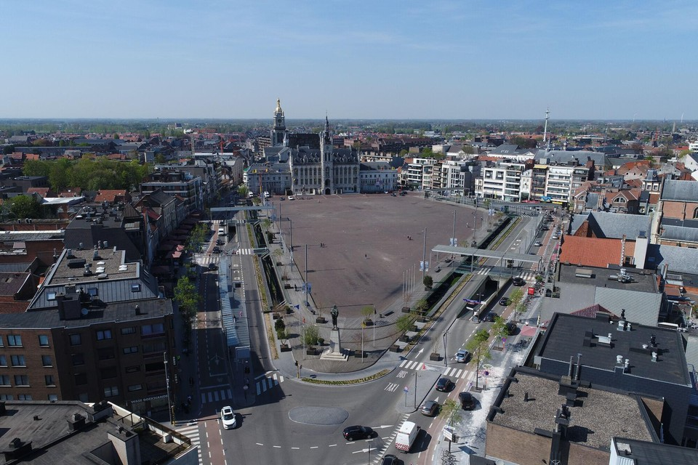

Slide 10
What we also want…
To improve safety and livability by avoiding cruising and searching for parking
by shifting on-street to off-street parking

Slide 11
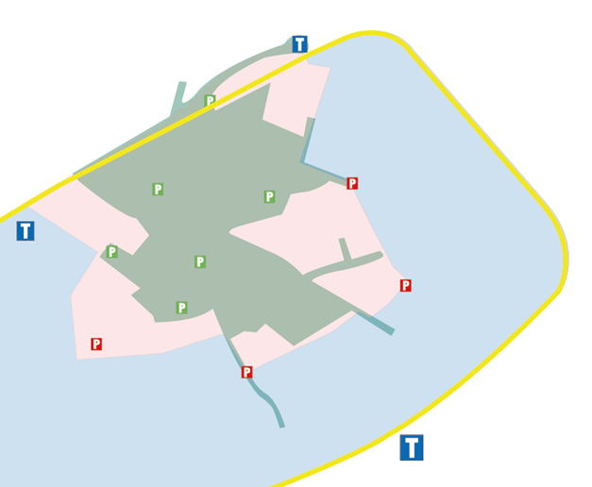
What we want - segregation parkings per user
Lower capacity on-street parkings
Inhabitants/visitors
Visitors/inhabitants
Visitors/Commuters

Slide 12
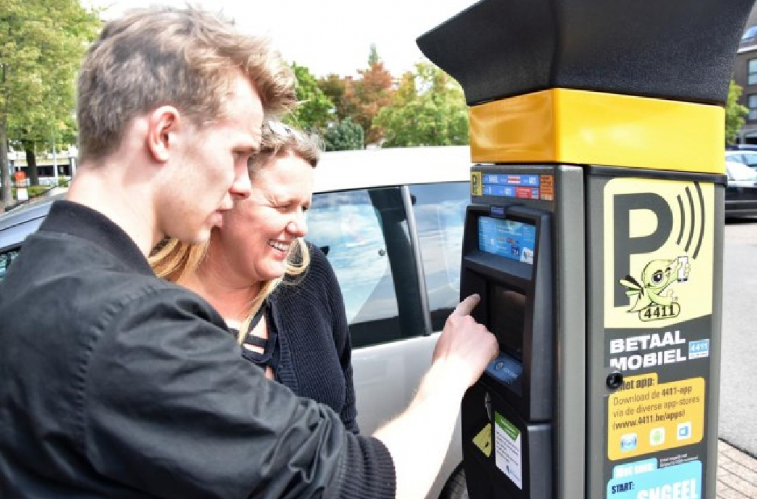
What we have – 100 digital parking meters

Slide 13
What we have – online parking products
Full digitization of parking products
Pay via app, website or text message for on-street parking
Pay your fine
Order parking prohibition signs
Order subscriptions for on-street parking

Slide 14
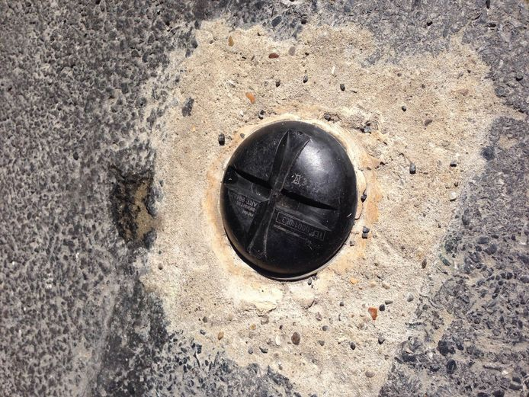
What we have - sensors

Slide 15
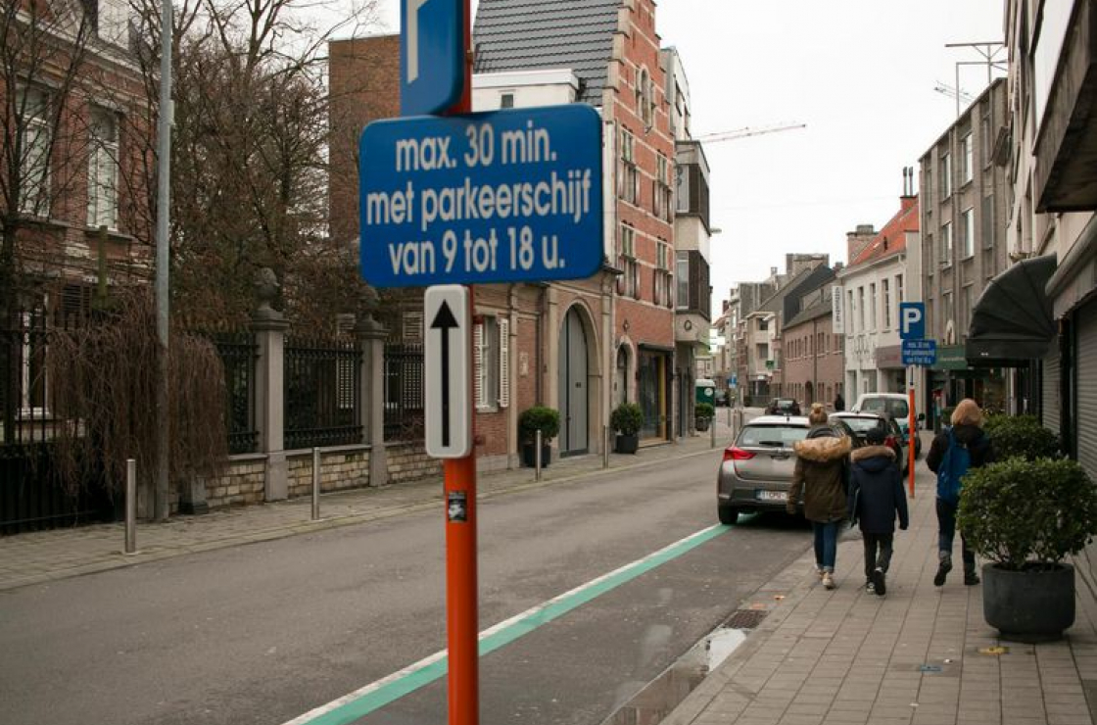
What we have - sensors
Shop & Go
Quick shopping
30 minutes for free
+ 35 zones
+ 100 parking spots
26 sensors - occupancy & rotation

Slide 16
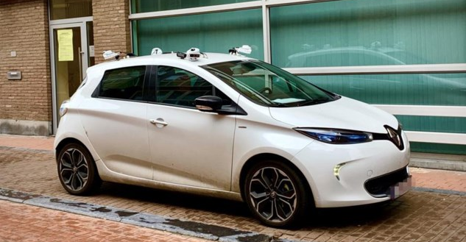
What we want – to optimize enforcement

Slide 17
What we want – more efficient enforcement
Scan car
Ticketless
Efficiency
Data & analysis
Smart City

Slide 18
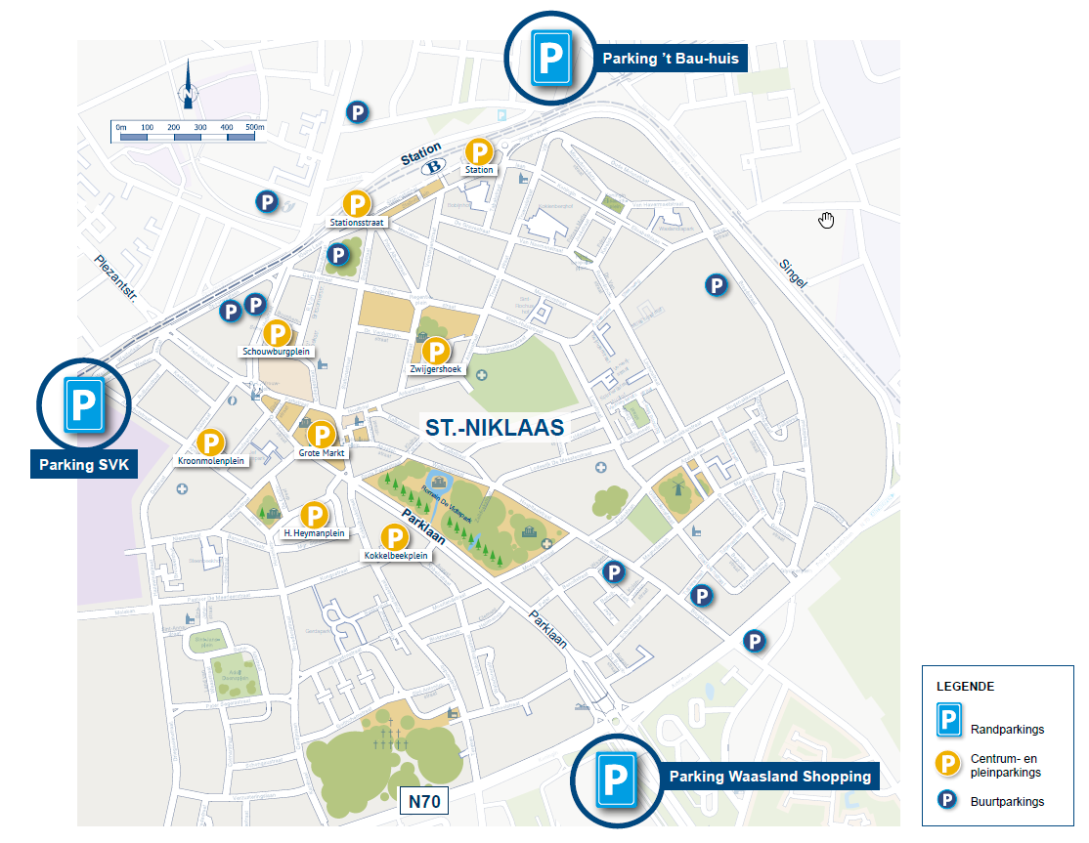
Parkings

Slide 19
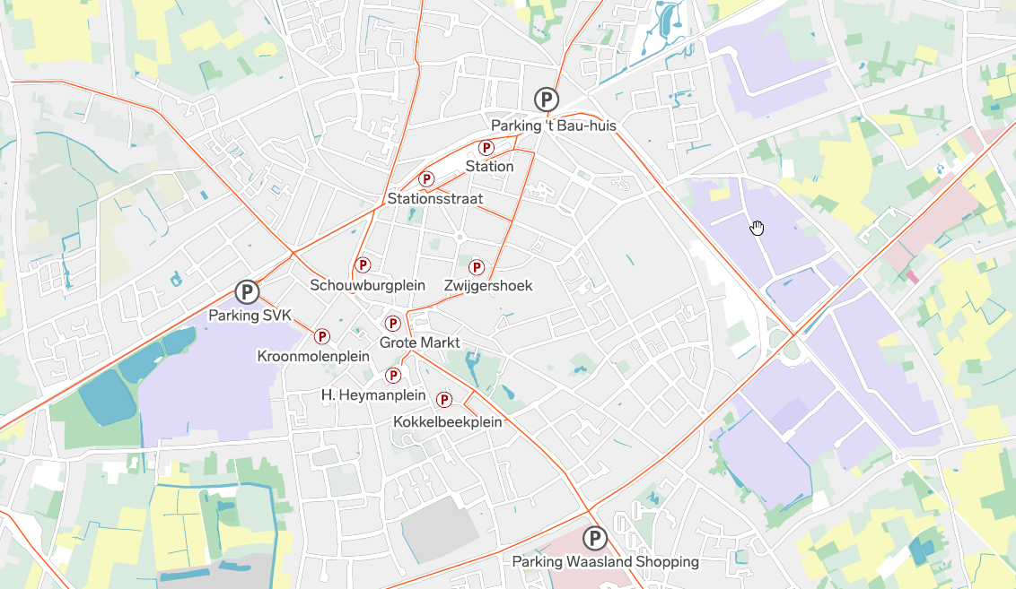
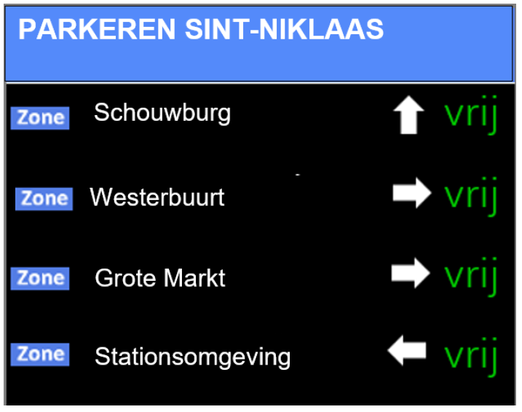
Notes:
de invoering van een nieuw en dynamisch aanpasbaar parkeerverwijzingssysteem op de belangrijkste invalswegen van de stad, dat de snelste en veiligste route aanduidt naar de parkings voor de bezoeker, inclusief de verwijzing naar het dichtstbijzijnde alternatief;

Slide 20
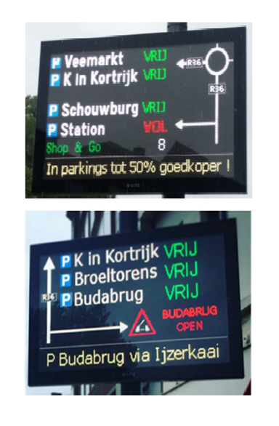
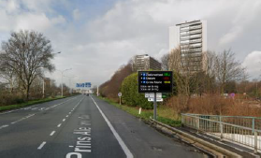
What we want – a dynamic parking guidance system How to steer your visitor or commuter?
Guidance to the different parkings
Occupancy rate
Communication about prices
Construction works and car accidents

Slide 21
Are we future proof?
Evolution to traffic management
Measure, monitor and evaluate traffic flows, congestions, travel time and parking occupancy
Dynamic control of traffic lights
Dynamic speedharmonisation
Real-time information via in-car app

Slide 22
Are we future proof?
Evolution to traffic management
Integration of additional measurement systems (ANPR camera’s, loop detectors,…)
Links with systems of other cities and organisations (public transport,…)
Mobility database with useful information and evaluation tools
…

Slide 23
Contact details
Stefan Van den Branden
Mobility Advisor
stefan.vandenbranden@sint-niklaas.be
+32 3 778 32 50

