Slide 1
Optimizing space occupancy
Peter Dingemans
Dingemans Management B.V.

Slide 2
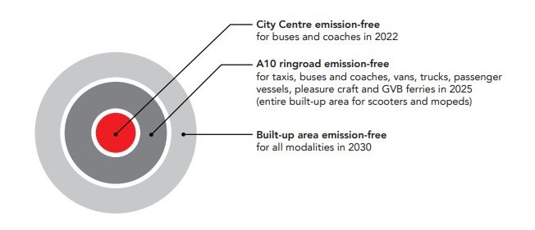
Optimizing space occupancy
Objectives
Parking policies
Reduce search traffic
Reduce CO2 emissions
Make cities more livable
EUROPEAN PARKING ASSOCIATION
Positively promoting parking solutions for sustainable mobility
POLIS-EPA webinar - March 2nd 2022

Slide 3
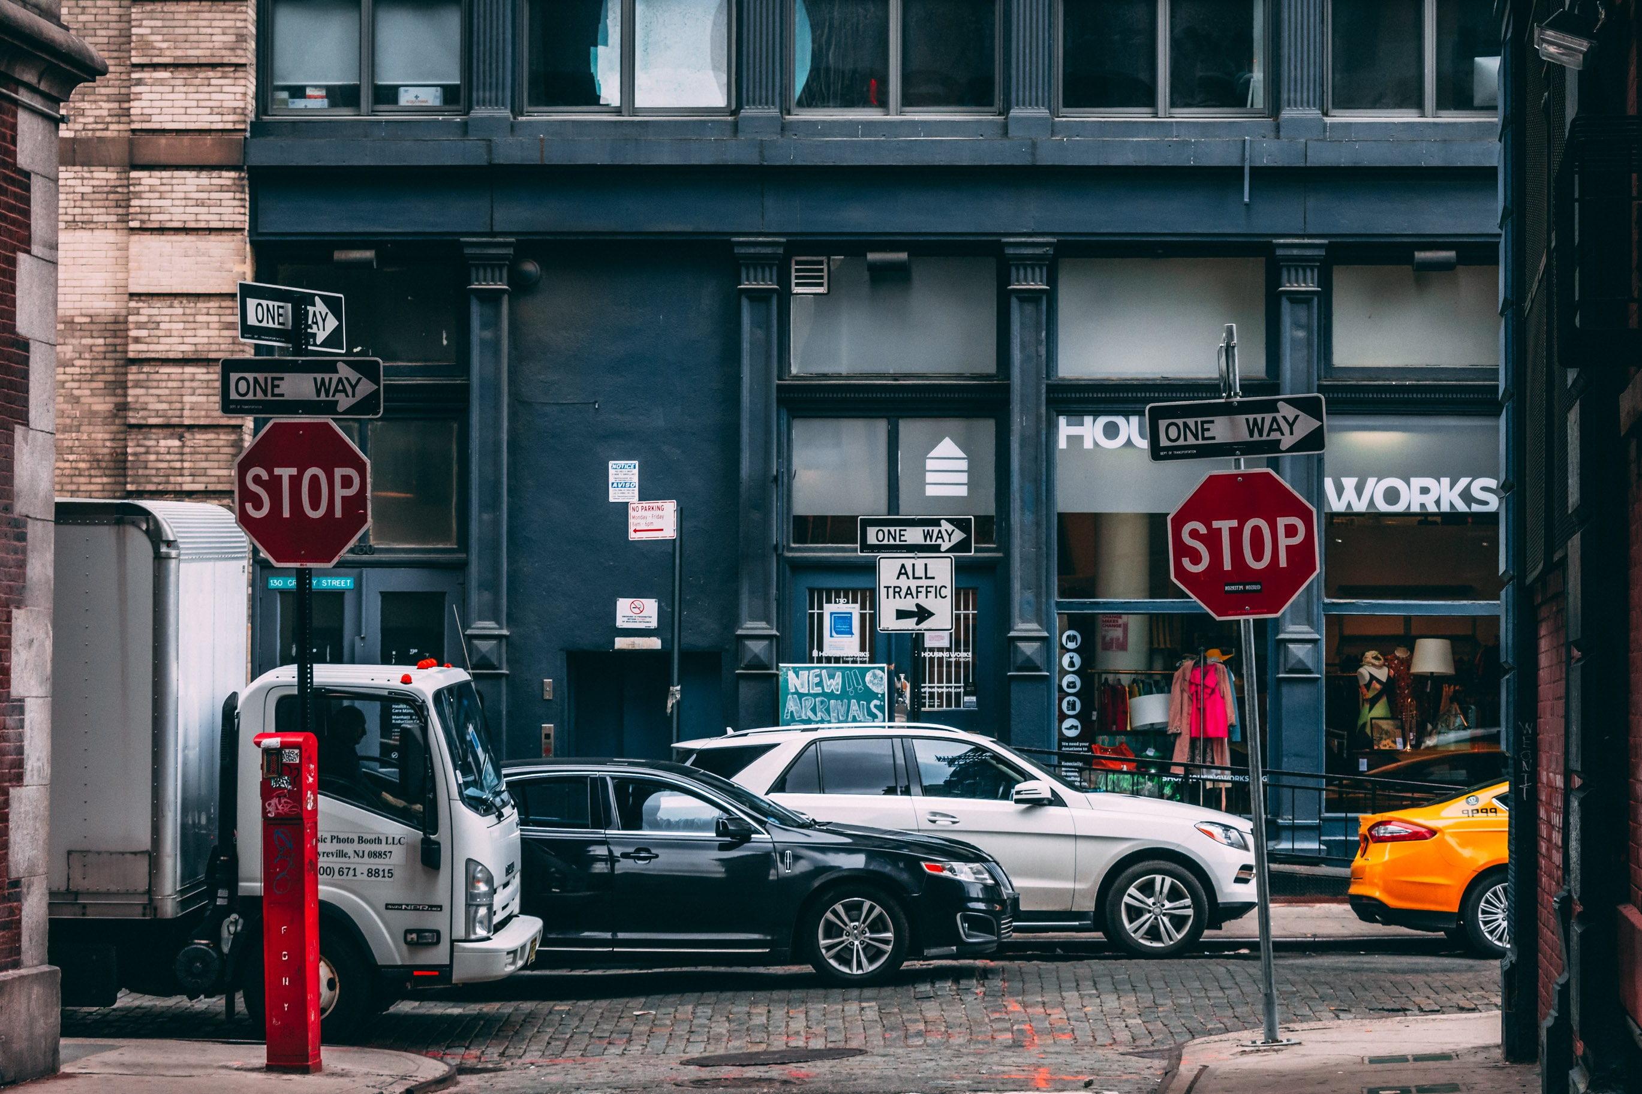
Optimizing space occupancy
Today’s world
On-street parking
Off-street parking – PARCS
Enforcement
PGS - Parking Guidance Systems
Single space detection
EUROPEAN PARKING ASSOCIATION
Positively promoting parking solutions for sustainable mobility
POLIS-EPA webinar - March 2nd 2022

Slide 4
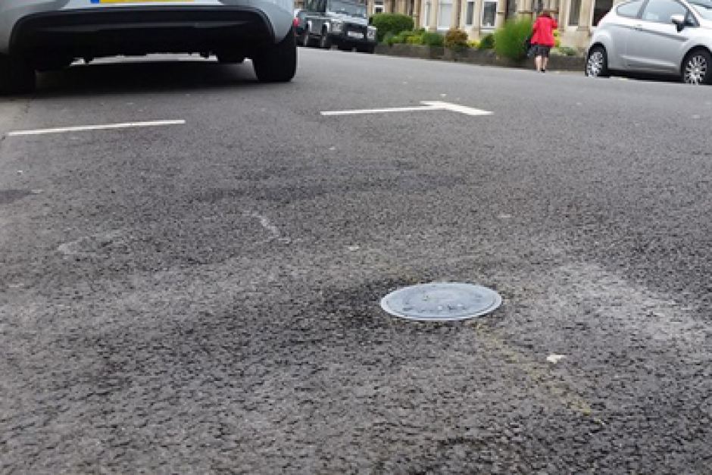
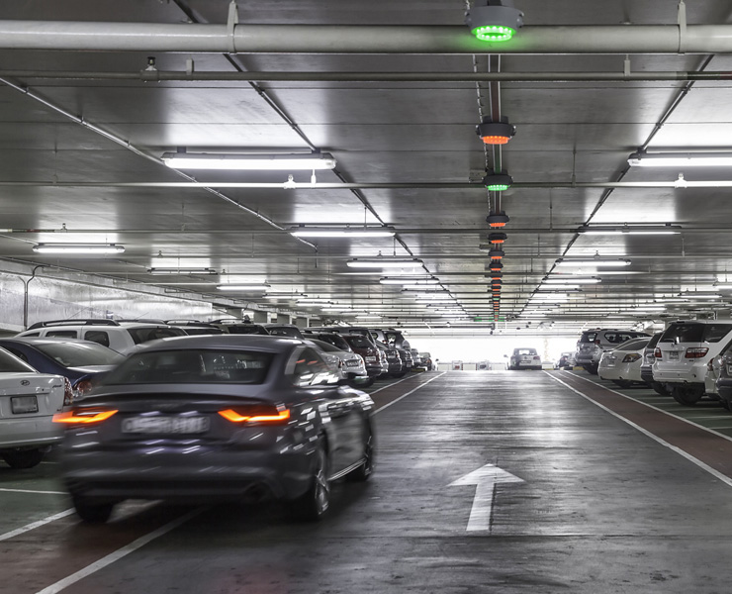
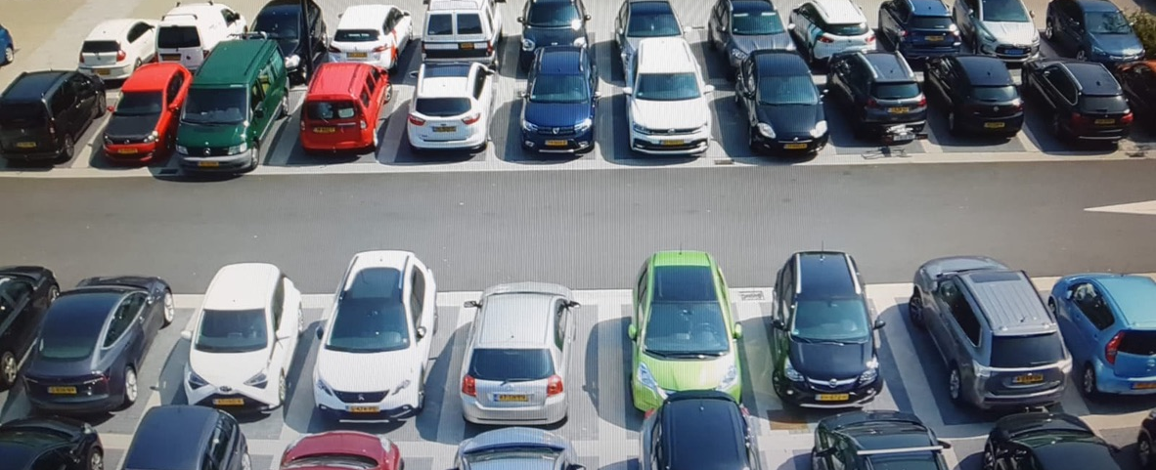
Optimizing space occupancy
Single space detection
(Smart) sensors based
In-ground sensors
Camera/ vision-based sensors
Software (app) based
Probability map-based space detection
Community based detection
EUROPEAN PARKING ASSOCIATION
Positively promoting parking solutions for sustainable mobility
POLIS-EPA webinar - March 2nd 2022

Slide 5
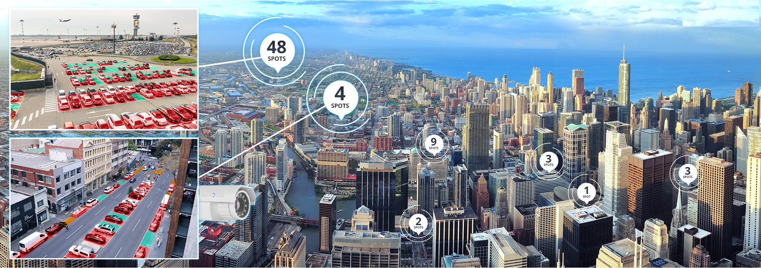
Optimizing space occupancy
New applications & technologies – (dynamic) occupancy information
Mobile paid parking
Navigation apps
In-vehicle sensor systems
Kerbside management
Urban Vehicle Access Regulations
EUROPEAN PARKING ASSOCIATION
Positively promoting parking solutions for sustainable mobility
POLIS-EPA webinar - March 2nd 2022

Slide 6
Optimizing space occupancy
EUROPEAN PARKING ASSOCIATION
Positively promoting parking solutions for sustainable mobility
POLIS-EPA webinar - March 2nd 2022

Slide 7
Optimizing space occupancy
Recommendations
Define requirements in line with your parking policy and objectives
Include multi-channel communication
Secure access to (open) dynamic parking data & interoperability
Include connectivity with open parking data standards
Assure data security and data privacy (GDPR)
Evaluation of solutions on TCO basis
EUROPEAN PARKING ASSOCIATION
Positively promoting parking solutions for sustainable mobility
POLIS-EPA webinar - March 2nd 2022

Slide 8
Contact
Peter Dingemans
Dingemans Management B.V.
peter.dingemans@icloud.com +31 611606257
EUROPEAN PARKING ASSOCIATION
Positively promoting parking solutions for sustainable mobility
POLIS-EPA webinar - March 2nd 2022

