Slide 1
The parking ecosystem – Using parking data to balance supply and demand
Morten Hother Sørensen
EasyPark Group

Slide 2
The problem of mismanaged parking space
x
x
!
x
Inefficiency
Lack of data
High congestion
Long parking
search time
Unoptimised tariffs and arbitrary selected parking zones that are not based on demand and supply causes inefficiency.
City planning and parking operations are inefficient without a cohesive overview of the parking infrastructure.
Congestion hampers accessibility and causes polluting emissions. Reducing these effects makes the city more livable.
Long parking searches costs time and money and cause frustration with residents and city guests.
Notes:
Move examples to speaker notes, we need to customise the examples to the city we are pitching to.
Inefficiency ex. pricing and zoning that do not incentivize drivers to park away from city center result in drivers to take chances to find parking in the city center. Adding congestion and lack of parking availability.
Lack of data ex. lack of data due to high number of analog P&Ds or unknown location of signs can turn enforcement and handling of fine appeals into an arduous task for all parties involved.
High congestion ex. the city of London adopted Net Zero Parking in 2018, an emission based tariff system where environmentally friendly cars pay less for parking resulting in up to 20% drop of polluting vehicles. Winning European Parking Award and positive media coverage.
Long parking search time ex. drivers in London spent in average 67 hours looking for parking, costing them £1,104 each in wasted time, fuel and emissions and the city as a whole £4.3 billion annually (source: INRIX Parking Pain UK, 2017).

Slide 3
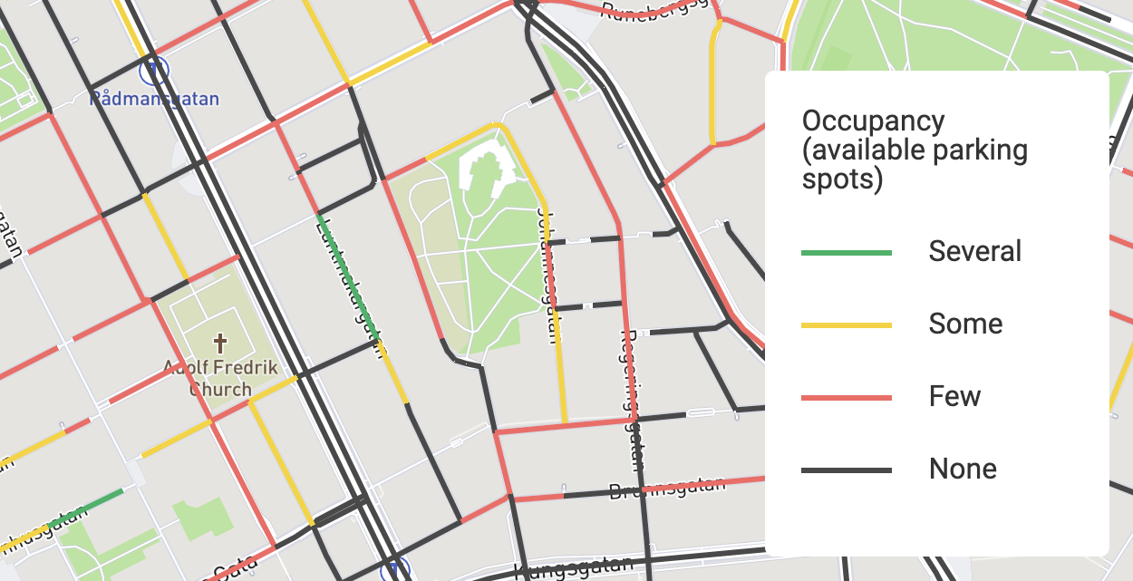
Helping cities make better policies
Parking Supply
Get a clear picture of the parking supply; where the parking spaces are located and how many there are, with access to a digital sign library to know what rules and restrictions apply and the allowed parking duration.
Parking Demand
Look at the parking demand in each street section. Know the average parking search time for the area and take informed action towards determining the correct pricing and zoning.
Notes:
Explanation of what occupancy and inventory is without using the Parking Inventory and Parking Demand yet.

Slide 4
The operation
Operational Parking Data from the smartHUB
DEMAND
Consumer
groups
ENABLERS
Multi providers
Multi technology
SUPPLY
City assets
SERVICES
CONTROLLING
Camera parking
CarPlay
smartHUB
Permits
HUB
PDAs
In-car integration
Parking Data as a Service
Find & park
Mobile paid parking
EV charging
Scan cars
Off-street
Notes:
Copenhagen

Slide 5
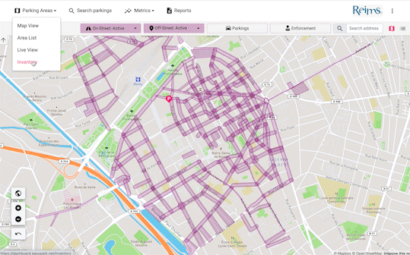
The supply
Parking inventory
What does my parking inventory looks like?
Determine the types and number of parking spaces available in each tariff zone.
Inspect different street segments and see what restrictions apply.
View all parking spaces, including electric vehicles, disabled parking and loading zones with the click of a button.
What kind of parking space do I have and where?
Given the demand profile are my policies such as zoning, pricing and permit well balanced?
Where are my paid parking zones?

Slide 6
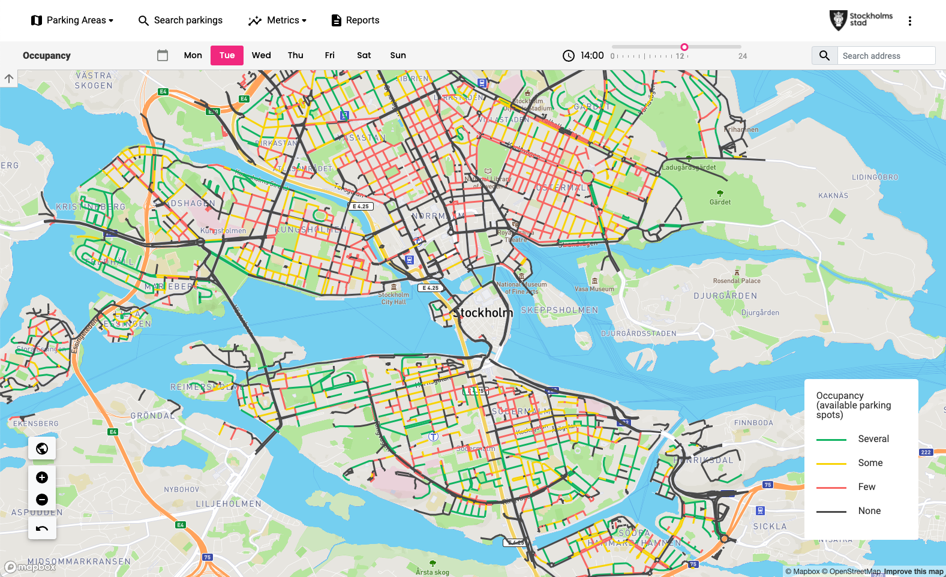
The demand
Parking Occupancy
What does my parking demand profile look like for a time and day in certain parts of the city?
Discover which streets and areas are most sought-after and figure out the probability of finding an open spot at any given time.
Additionally, our algorithm predicts how long visitors will need to spend searching for a parking space on average.
What does parking behaviour look like outside of my regulated/paid zone?
What’s the average duration it takes drivers to find parking?
What are the effects of my current parking policies on curb-side rotation?

Slide 7
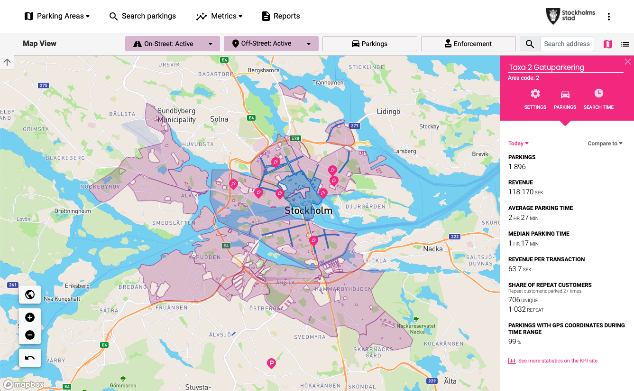
The operation
Operational Parking Data
Can I show operational statistics for any part of the city and compare any time region to any other, with a click of a button?
Track your zoning, pricing, enforcement, revenue, and other operational data in light of your inventory and occupancy.
Can I measure the seasonality of my parking transactions?
Do I know the average parking time per area from a demand perspective? For a particular time of the day?
Am I under-enforcing or over-enforcing in a particular location or time of the day?

Slide 8
The operation
Operational Parking Data
Capabilities:
Visualise enforcement and quick transaction checks when handling fine appeals.
Financial and operational overview of the city today and parking behavioural patterns.
Gain insight on the next steps to optimise, estimate and measure the impact of actions on key metrics.

