Slide 1
National Parking Platform Pilot
Emma Liptrot
Deputy Civil Enforcement Manager

Slide 2
Oxford City
Oxford is an historic and thriving city and is the tourism gateway to the rest of Oxfordshire. We attract approximately 7-million day‑time and staying visitors per year, generating £780 million of income for local Oxford businesses. In terms of overseas visitors to the UK, Oxford is the eighth most visited city for staying visits
On average, the arterial routes into the City centre have 38,000 vehicles travelling along them each day

Slide 3
What is the National Parking Platform?
It is a publicly owned, not for profit, national facility that enables parking operators (public or private) to communicate digitally with Service Providers.
The National Parking Platform project is funded by the Department for Transport, led by Manchester City Council and managed by Parking Matters.
It is designed to:
Aggregate information about parking space availability provided by car park operators and local authorities.
Integrate payment operations provided by mobile payment service providers.
Oxfordshire County Council have agreed to partake in this trial to enable the testing of the National Parking Platform software to help prove the concept.*

Slide 4
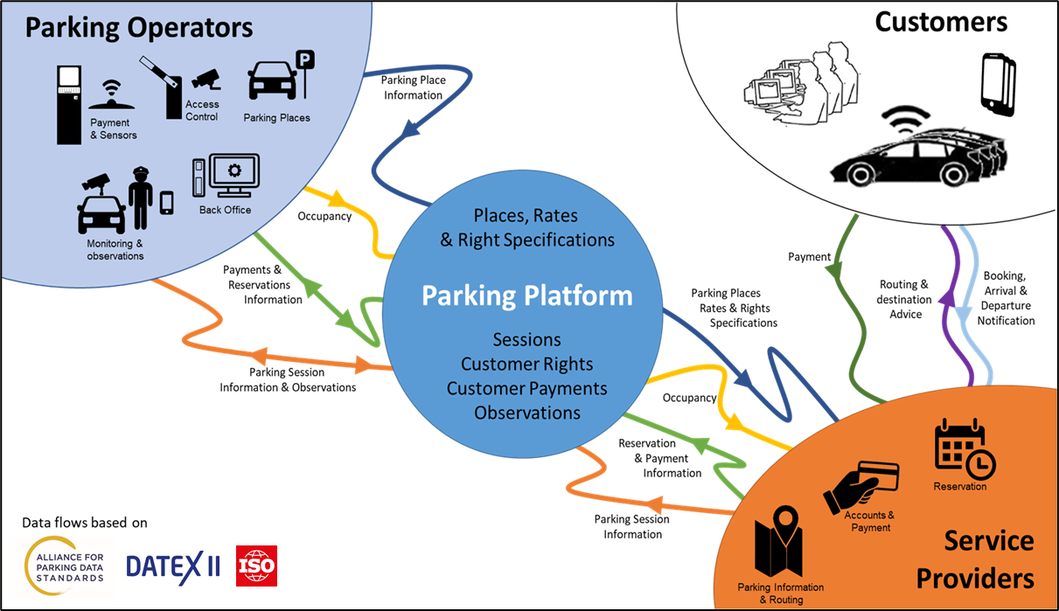
The Concept
A publicly owned, national facility that enables Parking Operators (public and private) to communicate digitally with Service Providers. The Platform is open to all Operators and Service Providers, enabling them to exchange the full range of parking information using APDS (ISO) standard interfaces.
Operators will be able to:
Describe the parking they offer (including rates, times, restrictions etc)
Publicise occupancy in real time*
Accept payments and reservations* without the need for a contract
Digitise compliance monitoring without the need for local digital infrastructure
Service Providers will be able to:
Offer their customers the ability to park in any Operator’s facility
Pay Operators for parking without the need for a contract with each one
Reserve spaces in Operator’s facilities*
Develop value added services based on standard, available information*.

Slide 5
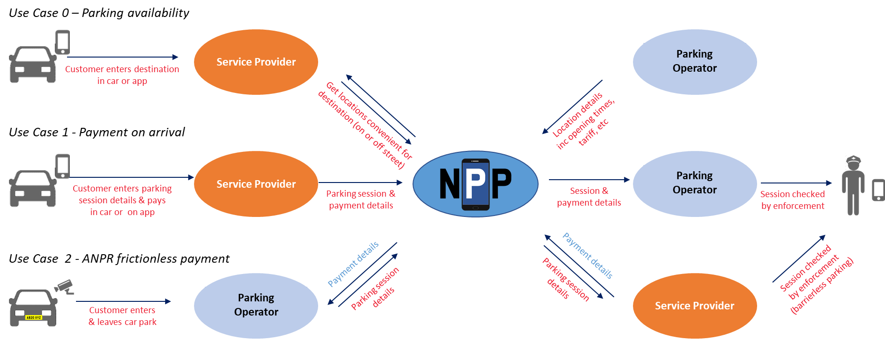
NPP Pilot Use cases – Improving the Customer Journey
The NPP Pilots demonstrate the three most common use cases. The use cases link the end customer and parking operator through a “Service Provider” (OEM platform or a customer account). Customers can access parking offered by any operator on the platform, paying through their Service Provider account.

Slide 6
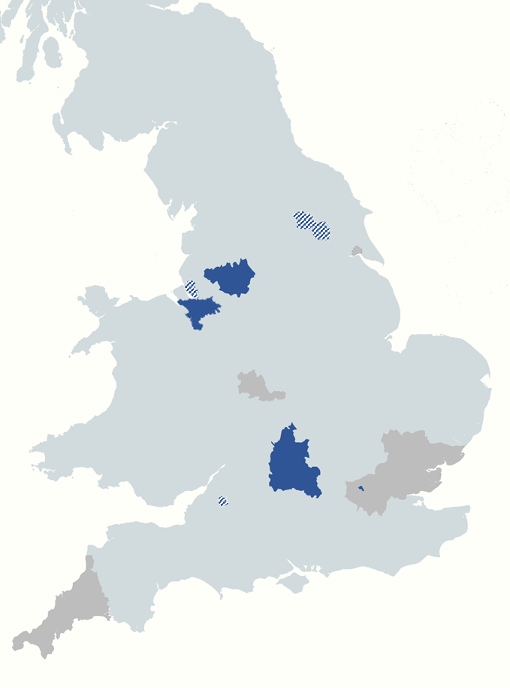
Pilot Coverage
The Pilot covers all use cases across a range of areas and operators. Currently there are:
7 Local authorities (including a London Borough) and 3 private operators
On street and off street locations
4 Service Providers able to take payments.
The Pilot project is on-boarding new operators & service providers to go live before the end of the year.

Slide 7
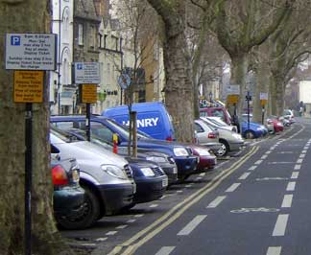
Our Trial Area
St Giles, Central Oxford (OX1)
160 On-Street parking spaces – short stay, max stay 2 hours
Single zone code recognised by all Service Providers
Ticketless sessions
70,000 Users per annum

Slide 8
Participating Service Providers
Oxfordshire County Council have contracted 3 Mobile App Service Providers for the course of the trial
Single zone code that will be recognised by all service providers
MOTO service provided by RingGo for the purpose of the trial

Slide 9
Benefits to the Council
Shift towards cashless parking - potential removal of P&D machines in the future
Potential expansion to other areas of Oxfordshire/ creation of on-street facilities with less infrastructure
Simplified payment journey for the consumer
Meet customer expectations by embarking on mobile app technology
Efficient enforcement patrols enabling redeployment of officers to more demanding areas
Helps the motorists to make informed choices prior to travelling into the City centre via GPS systems
Help to reduce carbon emissions in the City

Slide 10
Thank you!
Emma Liptrot
Deputy Civil Enforcement Manager
https://www.oxfordshire.gov.uk/residents/roads-and-transport/parking
More details:
National Parking Platform https://parkingmatters.com/project/national-parking-platform
Alliance for Parking Data Standards https://www.allianceforparkingdatastandards.org/

